Slide 1



FASHION ITEM CLASSIFICATION
By
Abhinendra Kumar
Aditi Narang
Arshad Nazeer
Ayush Rao Chaudhary
Anant Kumar

Slide 2
What is this Project About?
Project Question: Build an image classifier using the Fashion MNIST dataset to categorize clothing items. Visualize results using confusion matrix.
Automatically classify grayscale images of clothes into 10 categories.
Practical applications in fashion tech, e-commerce, tagging.
Dataset: Fashion MNIST from Kaggle (Zalando Research)
Problem: Low-resolution and visually similar items (e.g., shirt vs T-shirt).

Slide 3
Understanding the Dataset
Source: Kaggle – zalando-research/fashionmnist
Format: CSV with labels and 784 pixel values
Image size: 28 × 28 grayscale
10 classes:
0 = T-shirt/top
1 = Trouser
2 = Pullover
3 = Dress
4 = Coat
5 = Sandal
6 = Shirt
7 = Sneaker
8 = Bag
9 = Ankle boot

Slide 4
Preparing The Dataset
Loaded CSV from zip file using Pandas
Split into features (X) and labels (y)
Normalized pixel values: X / 255.0
Reshaped to (28, 28) images
Converted labels to one-hot encoding using to_categorical
Used train_test_split (80% training, 20% testing)

Slide 5
Model Used - Neural Network
Framework: TensorFlow & Keras
Model type: Sequential Feedforward Neural Network
Layers:
Flatten (input shape: 28x28 → 784)
Dense(128) – ReLU
Dense(64) – ReLU
Dense(10) – Softmax
Loss Function: Categorical Crossentropy
Optimizer: Adam
Activation: ReLU and Softmax

Slide 6
Training The Model
Epochs: 10
Batch size: Default (or mention if changed)
Validation done on 20% test set
Metrics tracked: Accuracy & Loss

Slide 7
Predictions on Test Images
Display 8–10 sample test images
Show true vs predicted labels
Mention good predictions and examples of misclassifications
Insight: Model struggles with visually similar items (e.g., Shirt vs T-shirt)
.

Slide 8
Confusion Matrix
Heatmap of predicted vs actual labels
X-axis: Predicted labels
Y-axis: True labels
Shows where model gets confused (e.g., Class 6 → Class 0)
Color intensity shows frequency

Slide 9
Detailed Classification Metrics
Precision, Recall, and F1-Score for each class
Overall Accuracy
High precision for unique classes like “Sandal” or “Sneaker”
Lower scores for ambiguous classes like “Shirt”

Slide 10
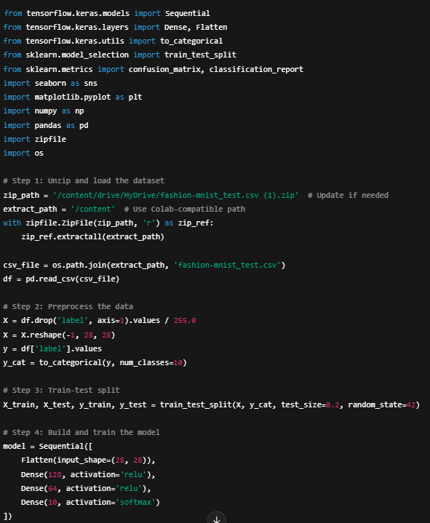
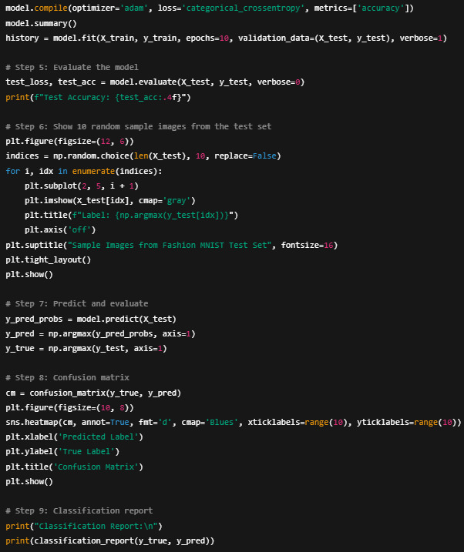
CODE

Slide 11
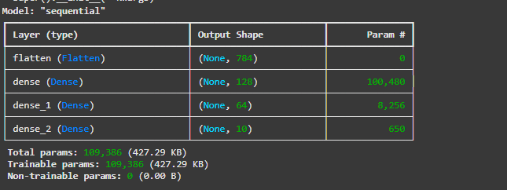
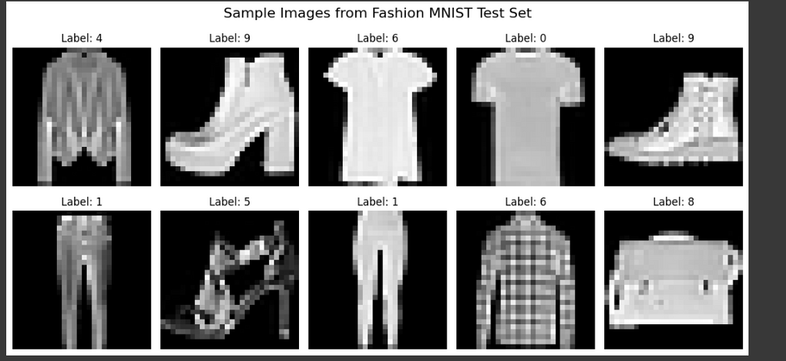
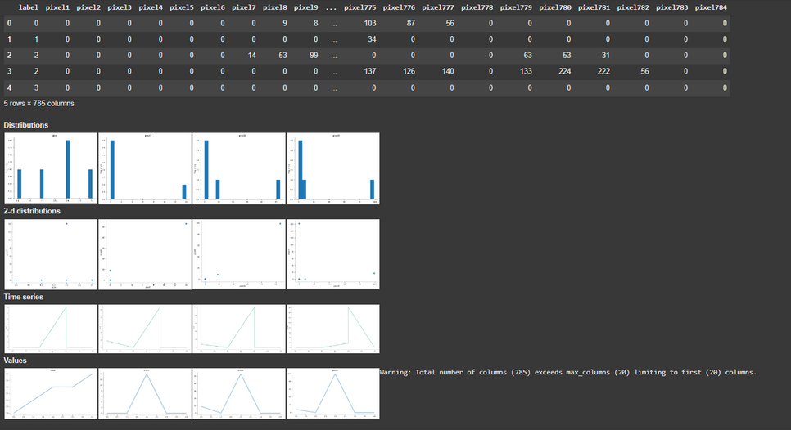
Output
.

Slide 12
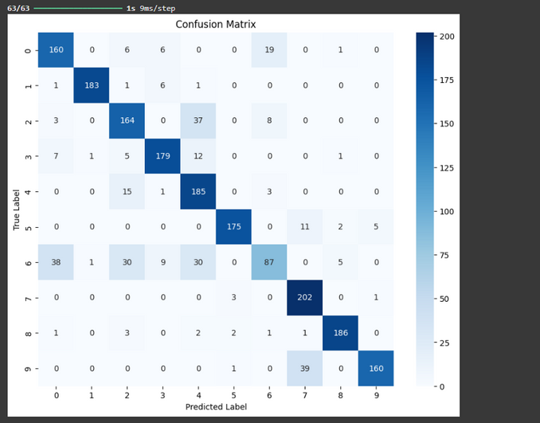
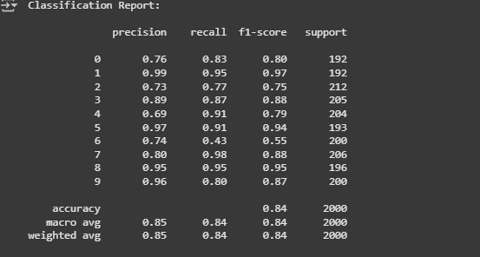
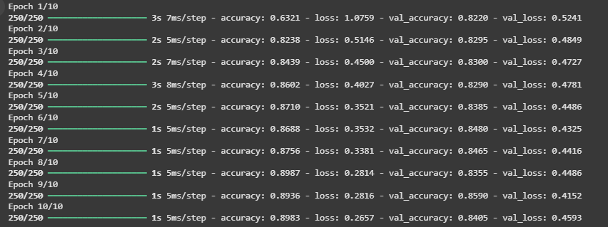
Output
.

Slide 13
Summary
Achieved good accuracy (~85–90%)
Clean performance on distinct items, but misclassifies similar ones
Could be improved with:
Convolutional Neural Network (CNN)
Data Augmentation
More training data
Regularization (Dropout)

Slide 14
THANK YOU

